Slide 1

DEFECT LIFE CYCLE
Jesús salatiel Bustamante robles

Slide 2
What is a defect ?
A Defect, is a flaw or an error in an application that is restricting the normal flow of an application by mismatching the expected behaviour of an application with the actual one.
It is the responsibility of a tester to do through testing of an application to find as many defects as possible to ensure that a quality product will reach the customer. It’s important to understand about defect life cycle before moving to the workflow and different states of the defect.

Slide 3
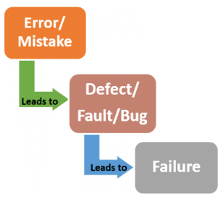
Errors, defects and failures
User interface Error
Syntactic error
The error is a human mistake
Flow control error
Medium
A defect is a variance between expected and actual result.
Low
Critical
Failure is a consequence of a defect

Slide 4
Defect life cycle
A Defect Life Cycle, also known as a Bug Life Cycle, is a circle of a defect from which it goes through covering the different states in its entire life. This starts as soon as any new defect is found by a tester and comes to an end when tester closes that defect assuring that it won’t get reproduce again.

Slide 5
Defect workflow
This the first state when any new defect is found, is falls in a “New State”
If the developer feels that the defect is not od very important priority and it can get fixed in the next releases.
If the defect is not considered as a genuine defect by the developer, then it is marked as “Rejected”.
New
Rejected
Deferred
Open
This the first state when any new defect is found, is falls in a “New State”
When the developer finishes the task of fixing a defect by making the required changes then be can mark the status of the status of the defect as “Fixed”
Fixed
Retest
Reopen
If any issue persists in the defect, then it will be assigned to the developer again for testing and the status of the defect gets changed to “Reopen”
The tester starts the task of working on the retesting of the defect to verify if the defect is fixed accurately by the developer as per the requirements or not.
Closed

Slide 6
Severity and priority, is there a difference ?
1. Severity: Defines the impact that a given defect has on the system.
For example: If an application or web page crashes when a remote link is clicked, in this case clicking the remote lnk by an user is rare but the impact of application crashing is severe. So the severity is high, but priority is low.
Status: Critical, Major, Moderate, Minor and Cosmetic
2. Priority: Defines the order in which we should resolve a defect. Should we fix it now, or can it wait. This priority is set by the tester to the developer mentioning the time frame to fix the defect.
Status: High, Medium and Low

Slide 7
References
https://www.softwaretestinghelp.com/bug-life-cycle/#:~:text=A%20Defect%20life%20cycle%2C%20also,won't%20get%20reproduced%20again.

